Slide 1
Toronto Shelter Occupancy vs Weather Impact
Group 4:
Yunfei Bai
Tayfun Umman
Hyun Kim
Jessica (Yuanyuan) Zou

Slide 2

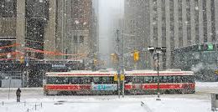
Background
7000 emergency and traditional shelter beds in Toronto
Demand keep increasing
Due to social, economic and political elements

Slide 3
Background
How about weather?
Cold winter
Hot summer
Extreme temperature
Rain
Snow

Slide 4
Background
Cold-weather Crisis for homeless (from news report)
Shortage of beds
launches investigation

Slide 5
Background
University of Calgary study
Shelter demand high during cold winter months
Also high with unpleasant weather
Rain, wet snow and sleet

Slide 6
Hypothesis
Severe weather conditions such as cold or hot temp, heavy rain and snow have direct impact on increase use

Slide 7
Objective
Perform data analysis on shelter occupancy rate and weather data in Toronto
Observe trends, statistical features or patterns on the data
Draw conclusion to accept or reject the hypothesis

Slide 8
Data Preparation

Slide 9
Data Preparation
- Shelter Occupancy <City of Toronto>
- Historical Weather <Governance of Canada>
Columns | Counts | Types
ORGANIZATION_NAME | 38700 | object
SHELTER_NAME | 38700 | object
SHELTER_ADDRESS | 38700 | object
SHELTER_CITY | 38700 | object
SHELTER_PROVINCE | 38700 | object
SHELTER_POSTAL_CODE | 36126 | object
FACILITY_NAME | 38700 | object
PROGRAM_NAME | 38700 | object
SECTOR | 38700 | object
OCCUPANCY | 38700 | int64
CAPACITY | 38422 | float64
Columns | Counts | Types
Year | 365 | int64
Month | 365 | int64
Day | 365 | int64
Data Quality | 0 | float64
Max Temp (°C) | 357 | float64
Max Temp Flag | 10 | object
Min Temp (°C) | 361 | float64
Min Temp Flag | 10 | object
Mean Temp (°C) | 355 | float64
Mean Temp Flag | 10 | object
Heat Deg Days (°C) | 355 | float64
Heat Deg Days Flag | 10 | object
Cool Deg Days (°C) | 355 | float64
Cool Deg Days Flag | 10 | object
Total Rain (mm) | 0 | float64
Total Rain Flag | 365 | object
Total Snow (cm) | 0 | float64
Total Snow Flag | 365 | object
Total Precip (mm) | 350 | float64
Total Precip Flag | 15 | object
Snow on Grnd (cm) | 60 | float64
Snow on Grnd Flag | 20 | object
Dir of Max Gust (10s deg) | 0 | float64
Dir of Max Gust flag | 365 | object
Spd of Max Gust (km/h) | 0 | float64
Spd of Max Gust Flag | 365 | object
Columns | Counts | Types
ORGANIZATION_NAME | 38700 | object
SHELTER_NAME | 38700 | object
SHELTER_ADDRESS | 38700 | object
SHELTER_CITY | 38700 | object
SHELTER_PROVINCE | 38700 | object
SHELTER_POSTAL_CODE | 36126 | object
FACILITY_NAME | 38700 | object
PROGRAM_NAME | 38700 | object
SECTOR | 38700 | object
OCCUPANCY | 38700 | int64
CAPACITY | 38422 | float64

Slide 10
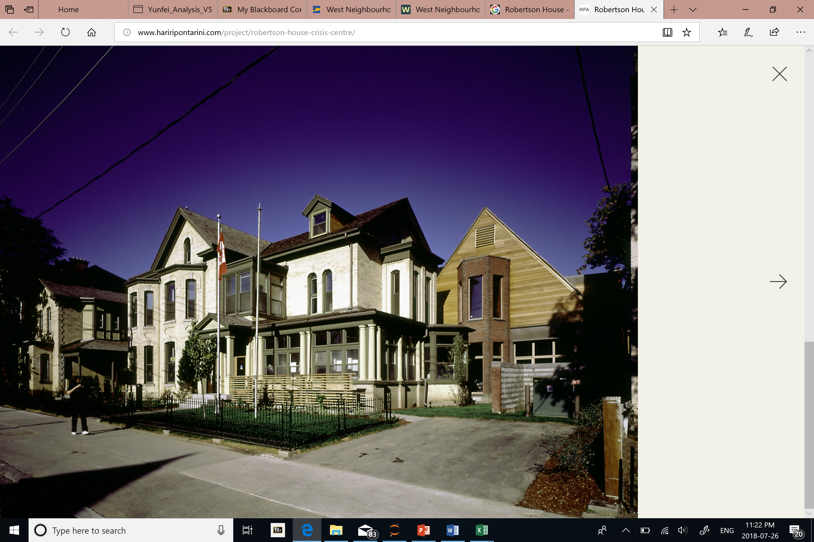
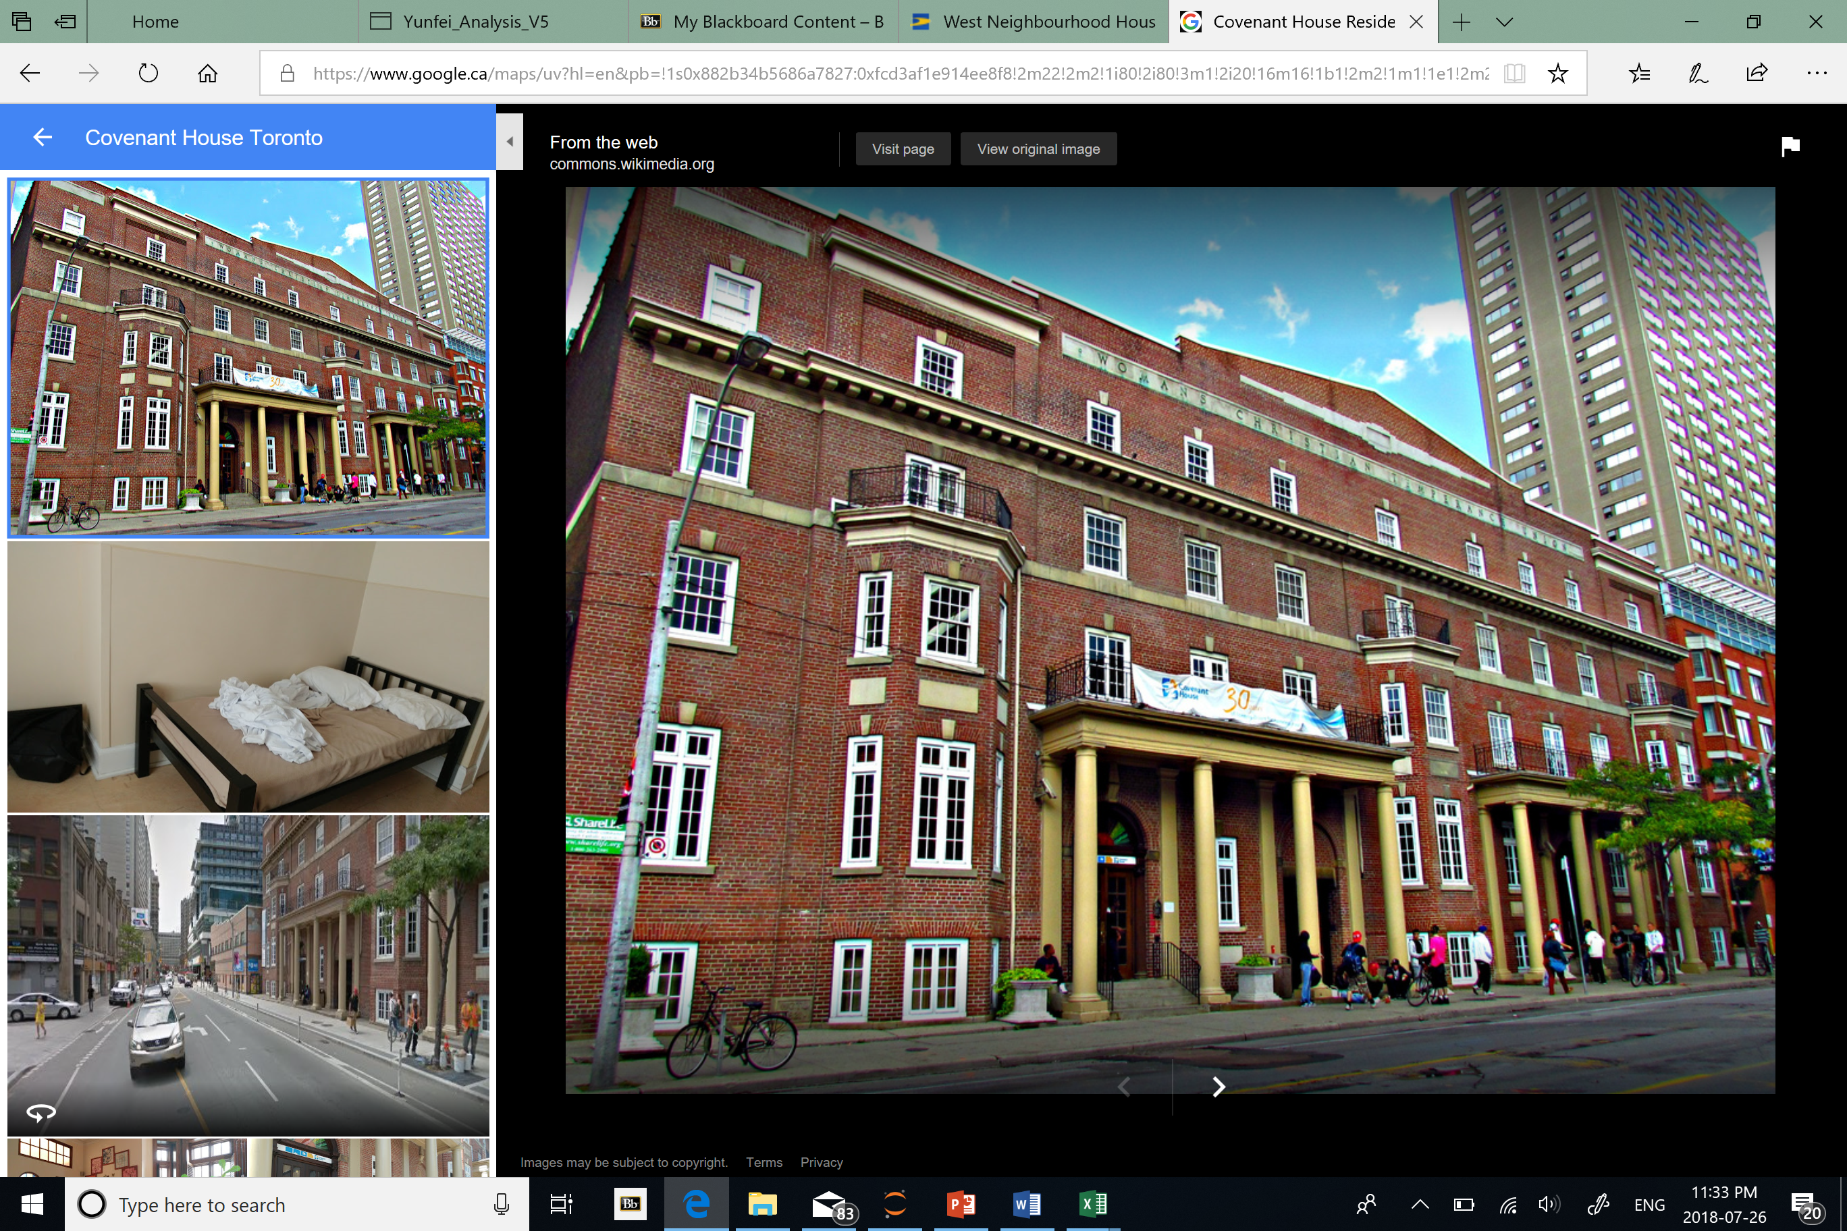
Data Preparation
Robertson House – Family type
- Historical Weather <Governance of Canada>
- Shelter Occupancy <City of Toronto>
Columns | Counts | Types
ORGANIZATION_NAME | 38700 | object
SHELTER_NAME | 38700 | object
SHELTER_ADDRESS | 38700 | object
SHELTER_CITY | 38700 | object
SHELTER_PROVINCE | 38700 | object
SHELTER_POSTAL_CODE | 36126 | object
FACILITY_NAME | 38700 | object
PROGRAM_NAME | 38700 | object
SECTOR | 38700 | object
OCCUPANCY | 38700 | int64
CAPACITY | 38422 | float64
Covenant House Residence
Columns | Counts | Types
ORGANIZATION_NAME | 38700 | object
SHELTER_NAME | 38700 | object
SHELTER_ADDRESS | 38700 | object
SHELTER_CITY | 38700 | object
SHELTER_PROVINCE | 38700 | object
SHELTER_POSTAL_CODE | 36126 | object
FACILITY_NAME | 38700 | object
PROGRAM_NAME | 38700 | object
SECTOR | 38700 | object
OCCUPANCY | 38700 | int64
CAPACITY | 38422 | float64
Columns | Counts | Types
Year | 365 | int64
Month | 365 | int64
Day | 365 | int64
Data Quality | 0 | float64
Max Temp (°C) | 357 | float64
Max Temp Flag | 10 | object
Min Temp (°C) | 361 | float64
Min Temp Flag | 10 | object
Mean Temp (°C) | 355 | float64
Mean Temp Flag | 10 | object
Heat Deg Days (°C) | 355 | float64
Heat Deg Days Flag | 10 | object
Cool Deg Days (°C) | 355 | float64
Cool Deg Days Flag | 10 | object
Total Rain (mm) | 0 | float64
Total Rain Flag | 365 | object
Total Snow (cm) | 0 | float64
Total Snow Flag | 365 | object
Total Precip (mm) | 350 | float64
Total Precip Flag | 15 | object
Snow on Grnd (cm) | 60 | float64
Snow on Grnd Flag | 20 | object
Dir of Max Gust (10s deg) | 0 | float64
Dir of Max Gust flag | 365 | object
Spd of Max Gust (km/h) | 0 | float64
Spd of Max Gust Flag | 365 | object

Slide 11
Data Preparation
- Shelter Occupancy <City of Toronto>
- Historical Weather <Governance of Canada>
Columns | Counts | Types
ORGANIZATION_NAME | 38700 | object
SHELTER_NAME | 38700 | object
SHELTER_ADDRESS | 38700 | object
SHELTER_CITY | 38700 | object
SHELTER_PROVINCE | 38700 | object
SHELTER_POSTAL_CODE | 36126 | object
FACILITY_NAME | 38700 | object
PROGRAM_NAME | 38700 | object
SECTOR | 38700 | object
OCCUPANCY | 38700 | int64
CAPACITY | 38422 | float64
Columns | Counts | Types
Year | 365 | int64
Month | 365 | int64
Day | 365 | int64
Data Quality | 0 | float64
Max Temp (°C) | 357 | float64
Max Temp Flag | 10 | object
Min Temp (°C) | 361 | float64
Min Temp Flag | 10 | object
Mean Temp (°C) | 355 | float64
Mean Temp Flag | 10 | object
Heat Deg Days (°C) | 355 | float64
Heat Deg Days Flag | 10 | object
Cool Deg Days (°C) | 355 | float64
Cool Deg Days Flag | 10 | object
Total Rain (mm) | 0 | float64
Total Rain Flag | 365 | object
Total Snow (cm) | 0 | float64
Total Snow Flag | 365 | object
Total Precip (mm) | 350 | float64
Total Precip Flag | 15 | object
Snow on Grnd (cm) | 60 | float64
Snow on Grnd Flag | 20 | object
Dir of Max Gust (10s deg) | 0 | float64
Dir of Max Gust flag | 365 | object
Spd of Max Gust (km/h) | 0 | float64
Spd of Max Gust Flag | 365 | object
Columns | Counts | Types
ORGANIZATION_NAME | 38700 | object
SHELTER_NAME | 38700 | object
SHELTER_ADDRESS | 38700 | object
SHELTER_CITY | 38700 | object
SHELTER_PROVINCE | 38700 | object
SHELTER_POSTAL_CODE | 36126 | object
FACILITY_NAME | 38700 | object
PROGRAM_NAME | 38700 | object
SECTOR | 38700 | object
OCCUPANCY | 38700 | int64
CAPACITY | 38422 | float64
Columns | Counts | Types
Year | 365 | int64
Month | 365 | int64
Day | 365 | int64
Data Quality | 0 | float64
Max Temp (°C) | 357 | float64
Max Temp Flag | 10 | object
Min Temp (°C) | 361 | float64
Min Temp Flag | 10 | object
Mean Temp (°C) | 355 | float64
Mean Temp Flag | 10 | object
Heat Deg Days (°C) | 355 | float64
Heat Deg Days Flag | 10 | object
Cool Deg Days (°C) | 355 | float64
Cool Deg Days Flag | 10 | object
Total Rain (mm) | 0 | float64
Total Rain Flag | 365 | object
Total Snow (cm) | 0 | float64
Total Snow Flag | 365 | object
Total Precip (mm) | 350 | float64
Total Precip Flag | 15 | object
Snow on Grnd (cm) | 60 | float64
Snow on Grnd Flag | 20 | object
Dir of Max Gust (10s deg) | 0 | float64
Dir of Max Gust flag | 365 | object
Spd of Max Gust (km/h) | 0 | float64
Spd of Max Gust Flag | 365 | object

Slide 12
Engineered Variables
O_Rates
Delta temperature

Slide 13
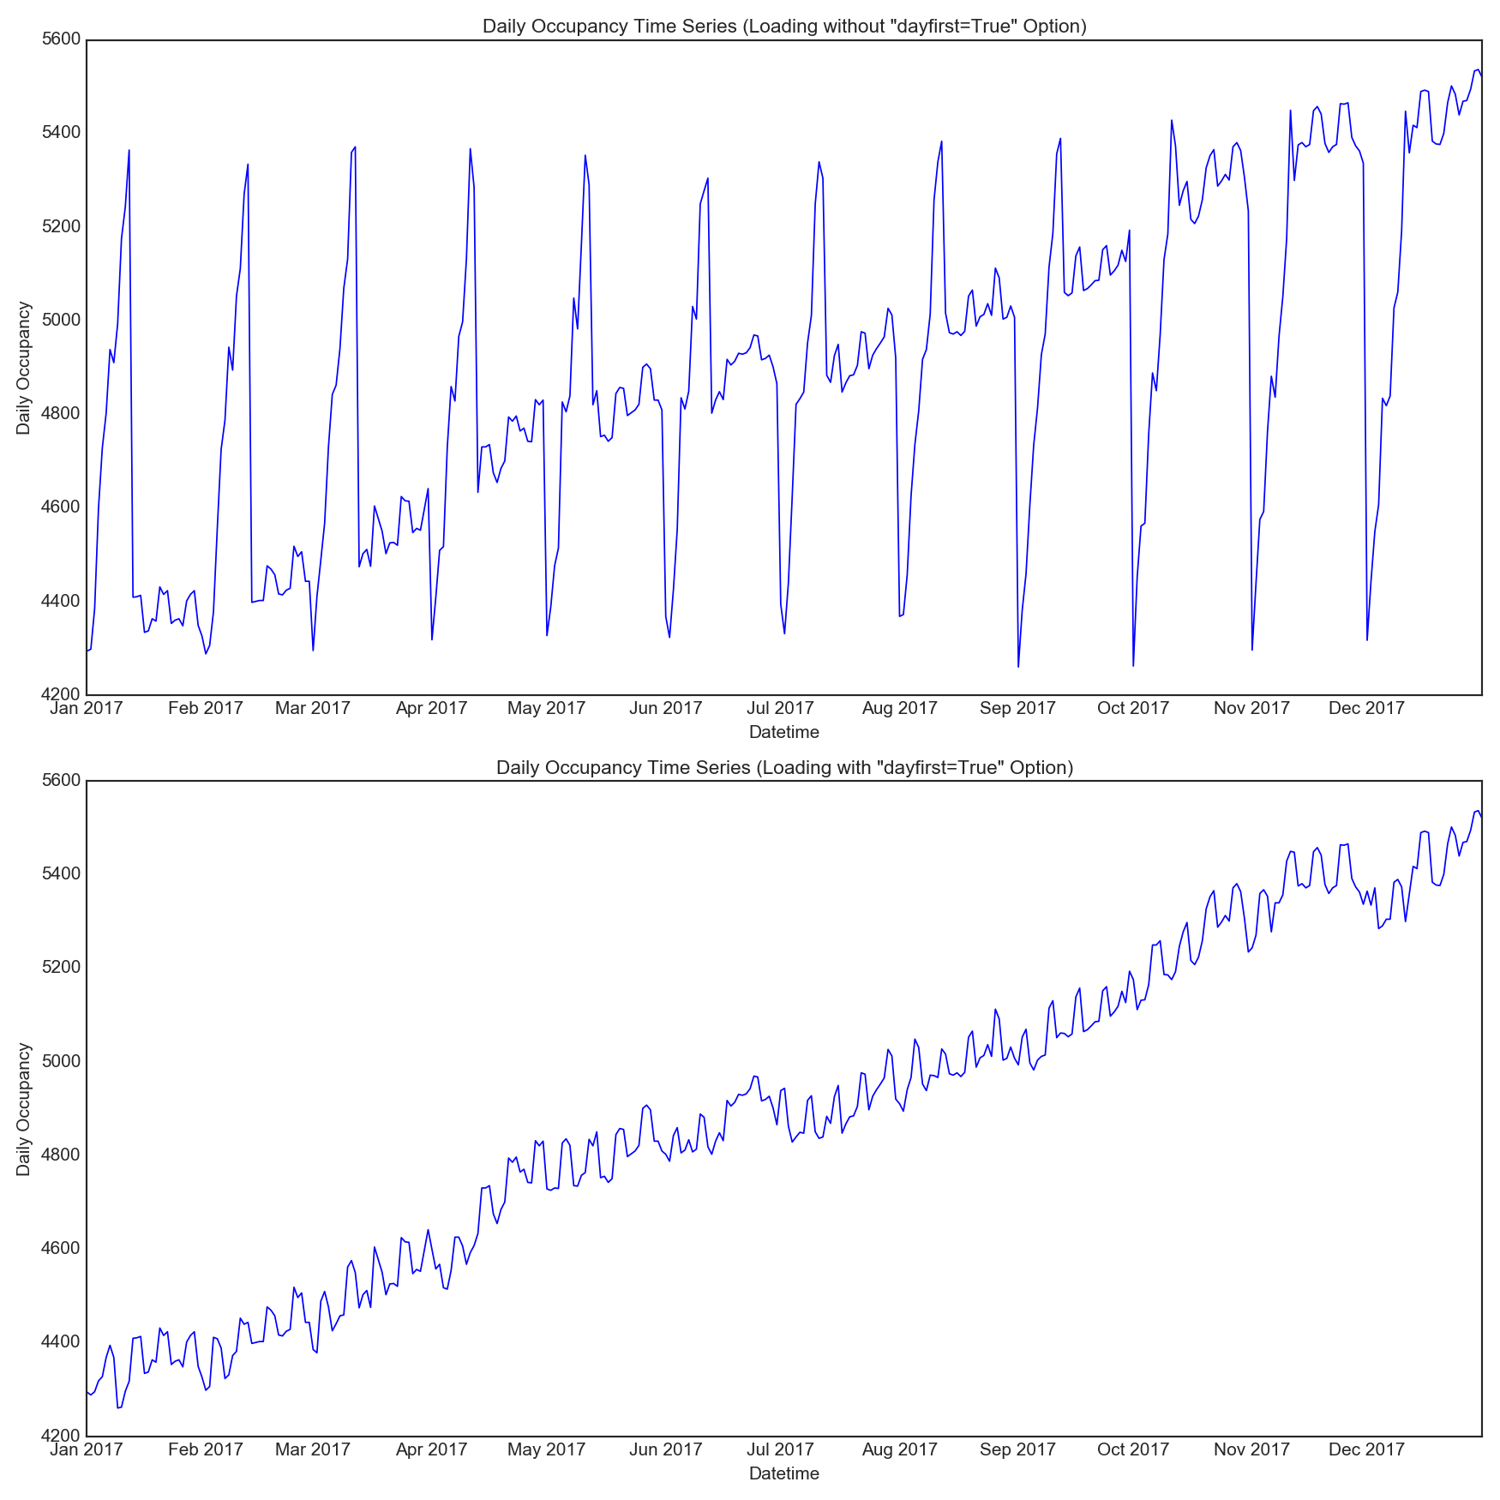
Challenge of the Data
12/1/2017
13/1/2017

Slide 14
GENERAL ANALYSIS

Slide 15
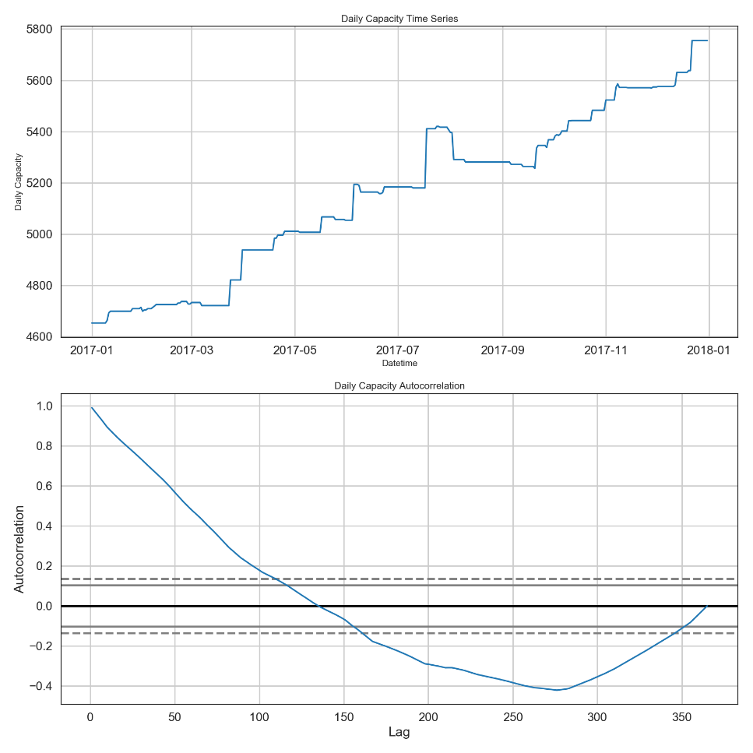
Capacity increased over the year
Notes:
Capacity showed a stepped increase. It is affected by the policies and usually a little delay and static for a period of time.
The autocorrelation is high within 100 days, showed a very predictable increase.

Slide 16
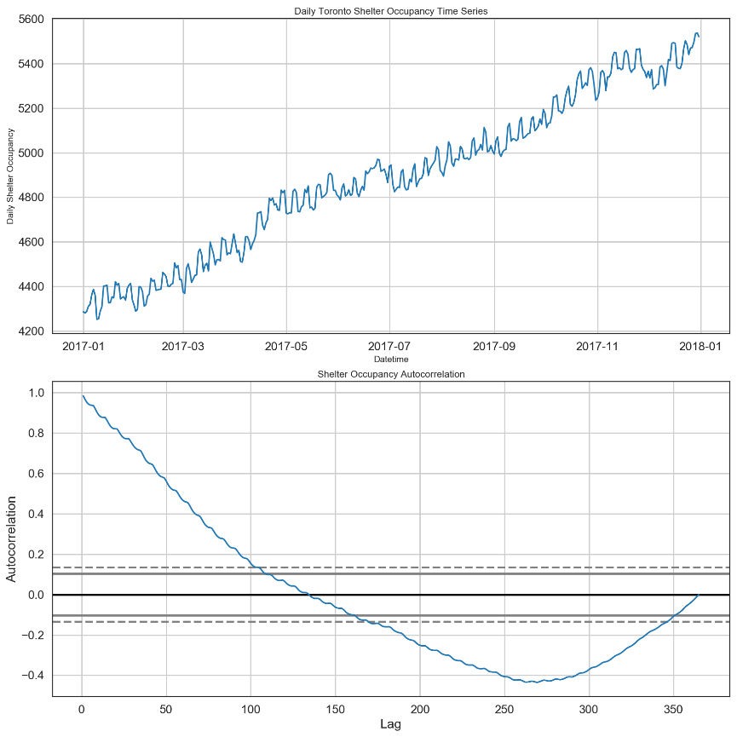
Occupancy increased with clear oscillation
Notes:
Shelter occupancy showed a steady increase.
The oscillation looks like a pattern in it
Autocorrelation: a very predictable increase, with a little oscillation as well.

Slide 17
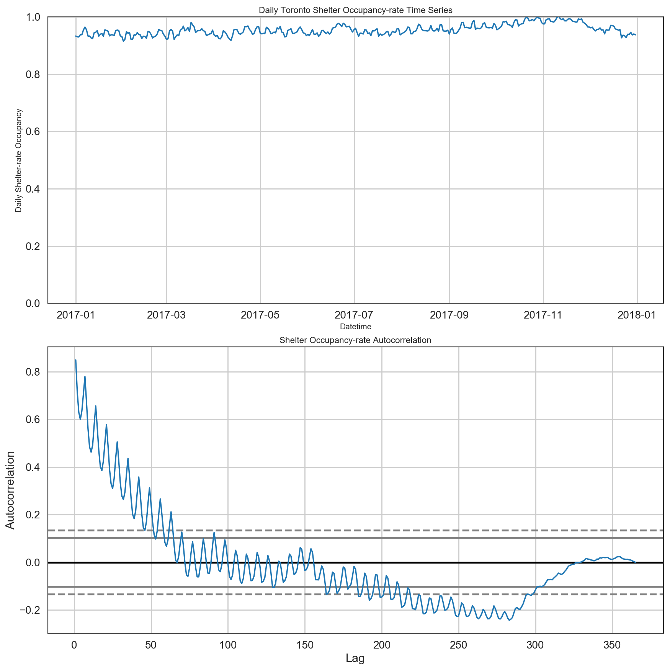
Autocorrelation of Occupancy rate showed a clear periodic pattern
Notes:
Shelter occupancy rate is fairly high throughout the year, around 96%.
Showed a little bit peak in March, June. And in November it can even reach over 100%.
The oscillation in autocorrelation function gives us a clear periodic pattern.
And for each 50 days we saw a total 7 peaks, that easily made us relate it to a weekly pattern.

Slide 18
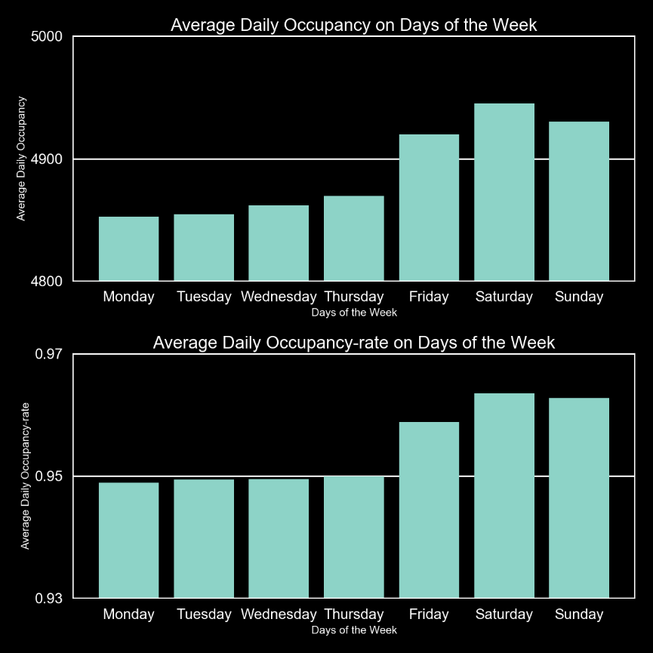
Weekdays Average Occupancy and Occupancy rate
Occupancies for Friday, Saturday and Sunday are about a number of 100 higher than the rest of the week
A
A
B
B
Occupancy rates for Friday, Saturday and Sunday are about 1-2% higher than the rest of the week.
Notes:
Occupancies for Friday, Saturday and Sunday (weekends) are about a number of 100 higher than the rest of the week. (about 2% difference)
Occupancy rates for Friday, Saturday and Sunday are about 1-2% higher than the rest of the week days.
To be honest, 2% is not a big difference in number but still gives us a small favor of demand difference between regular weekdays and weekends.
And we will have more details of this interesting pattern in later analysis.

Slide 19
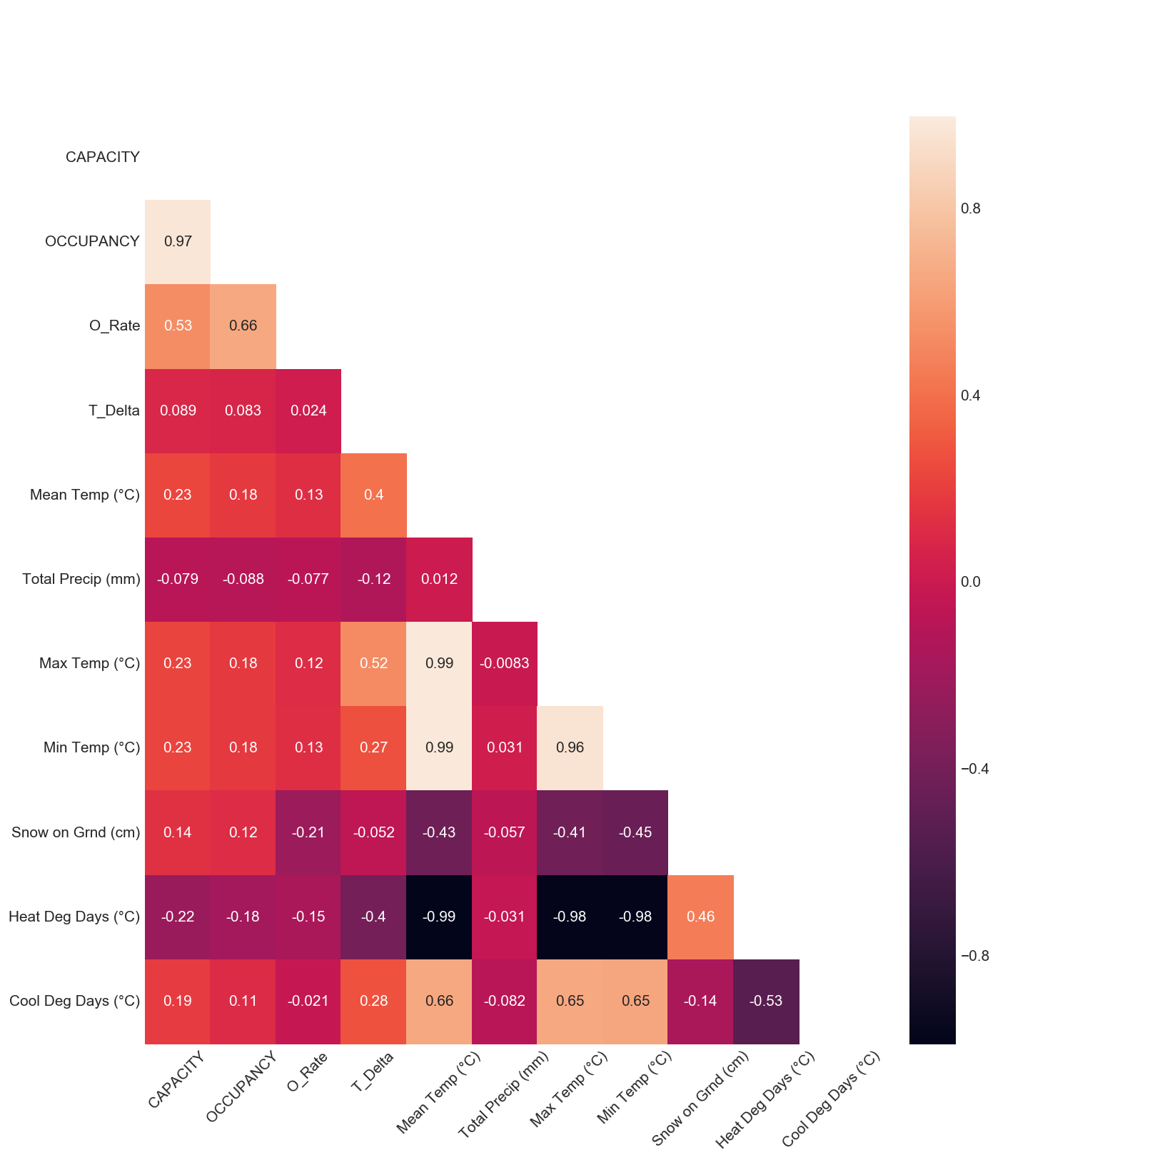
Shelter Variables and Weather Variables Correlation Heat Map
Very low correlation between shelter occupancy variables and weather variables
Notes:
One of our major objective is to study the relationship between shelters occupancy attributes and weather attributes.
This heap map three shelter variables: Capacity, Occupancy and Occupancy rate
However from this heat map, the correlation between shelter and weather variables is pretty low, the coefficient is around 0.2, no higher than 0.3.
It is quite opposite from our hypothesis.
So we want to take a closer look at it.

Slide 20
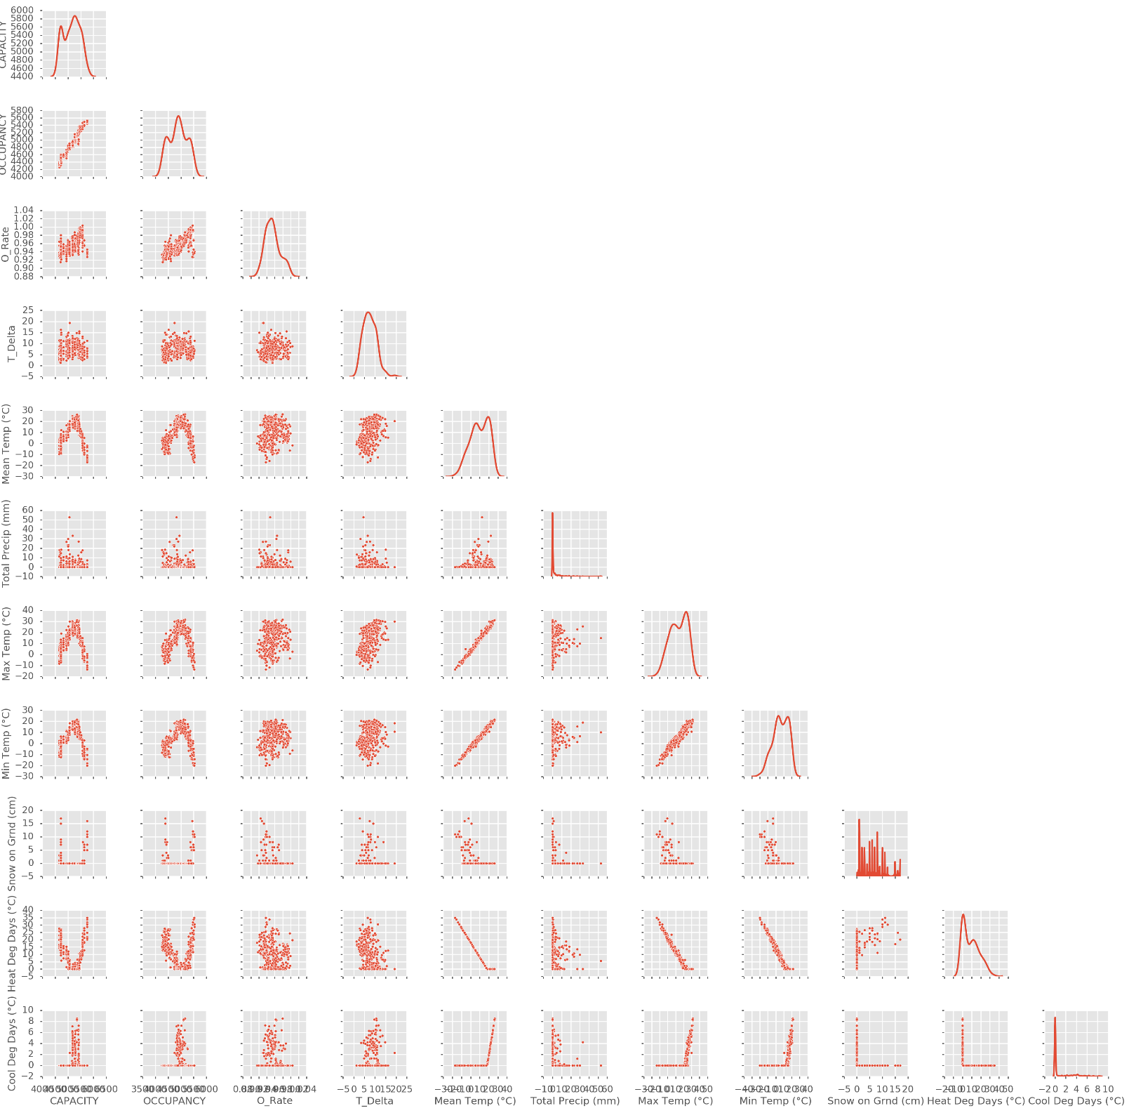
Scatter Matrix
seems to be a trend between shelter occupancy attributes (capacity/occupancy) and temperature related attributes (mean/max/min temp).
Notes:
The Scatter Matrix gives us a detailed look of their relationships.
From this Matrix, there seems to be a trend between shelter occupancy attributes (capacity/occupancy) and temperature related attributes (mean/max/min temp).
Seems along the occupancy axis, the temperature increases and decreases in linear.

Slide 21
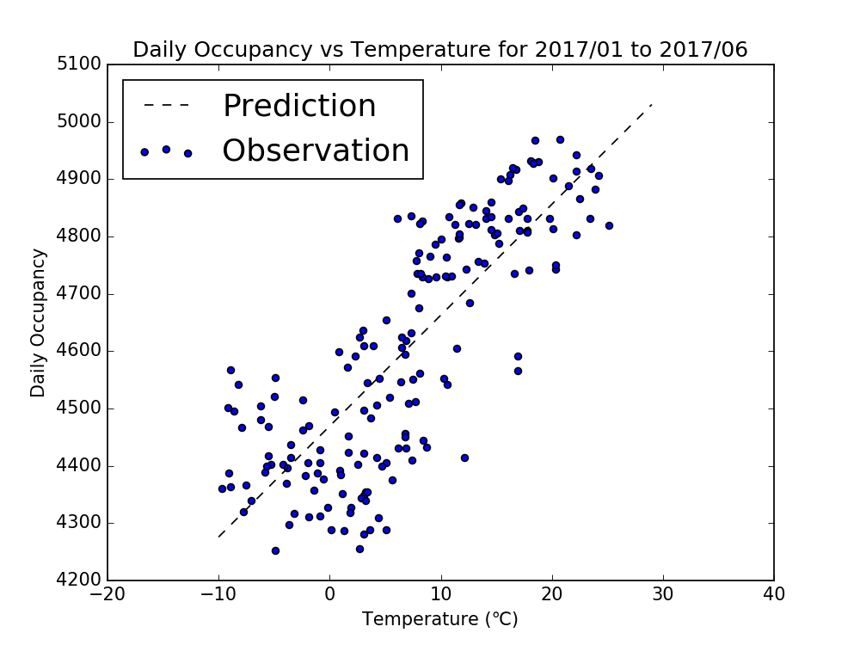
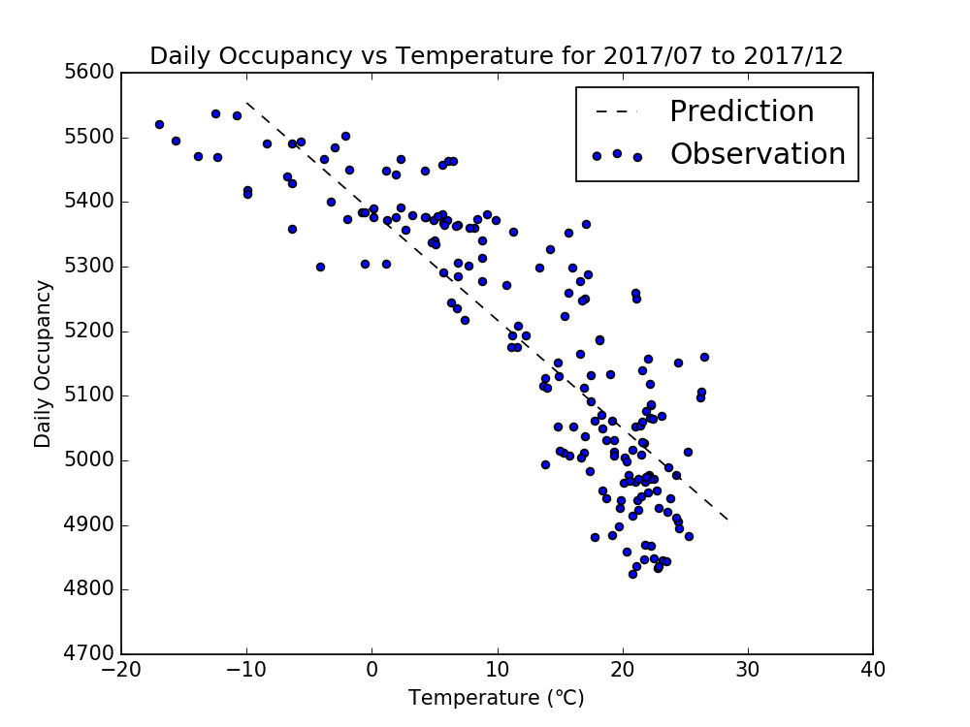
Is it a real correlation ?
Notes:
1.
As example, we plotted out the daily occupancy vs temperature for each of the half year and did a linear regression. It fits very well for the linear model.
And it seems like a linear correlation except they are completely opposite in two different half years. Is it a real correlation?
2.
If you bring graph that occupancy increases over the year and temperature increases and decreases over the year,
You will realize that in fact the occupancy is increasing over year, no matter what weather condition it is.
It just happens that temperature increases over the first half year and decrease over the second half year, so it seems a positive linear regression in first half year then negative linear correlation in the second half year.
The true correlation behind it is actually occupancy vs time.
3.
So why is that?
The city’s target for the occupancy rate is 90%, but actually it is well above 90%, around 96% average and even in November, it reached over 100%.
At least, from this study, shortage of shelter for city of Toronto is so predominant and demanding of the shelter capacity is so strong, that weather conditions have almost no impact on occupancy variation. Whenever there is more capacity provided, the spot will be taken immediately no matter what weather condition it is.

Slide 22
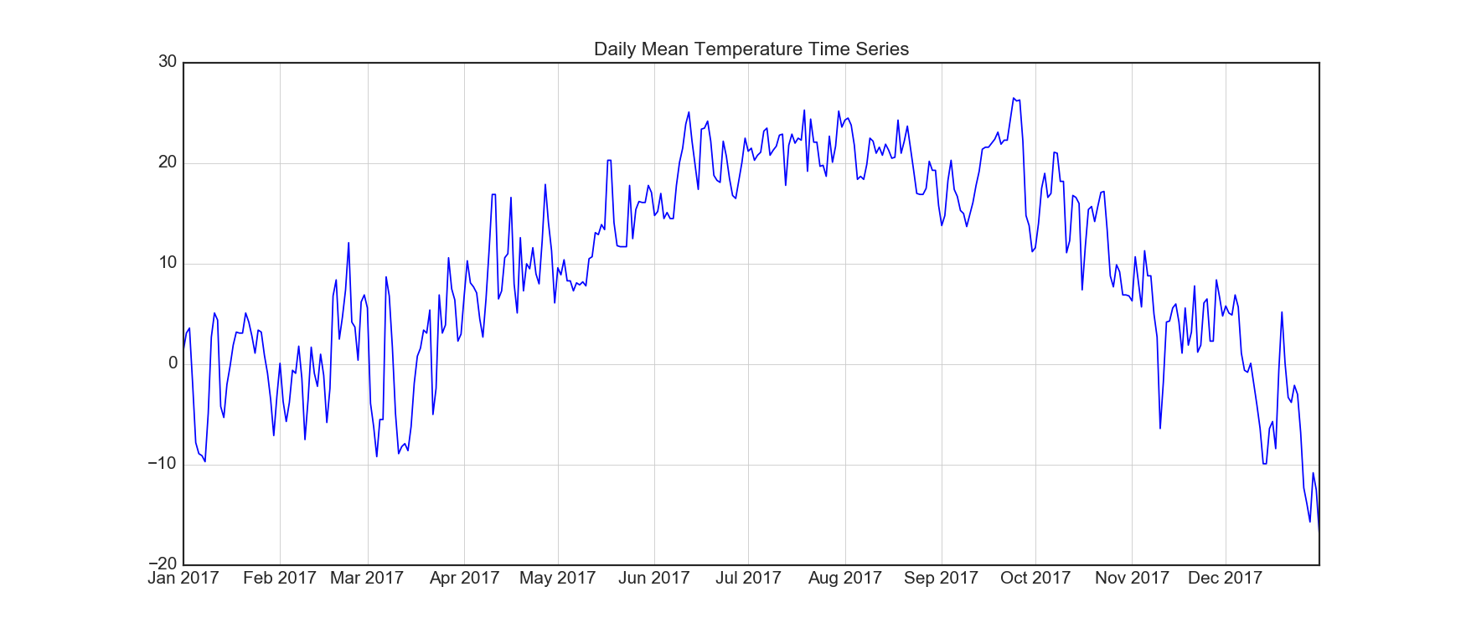
Is it a real correlation ?
Notes:
1.
As example, we plotted out the daily occupancy vs temperature for each of the half year and did a linear regression. It fits very well for the linear model.
And it seems like a linear correlation except they are completely opposite in two different half years. Is it a real correlation?
2.
If you bring graph that occupancy increases over the year and temperature increases and decreases over the year,
You will realize that in fact the occupancy is increasing over year, no matter what weather condition it is.
It just happens that temperature increases over the first half year and decrease over the second half year, so it seems a positive linear regression in first half year then negative linear correlation in the second half year.
The true correlation behind it is actually occupancy vs time.
3.
So why is that?
The city’s target for the occupancy rate is 90%, but actually it is well above 90%, around 96% average and even in November, it reached over 100%.
At least, from this study, shortage of shelter for city of Toronto is so predominant and demanding of the shelter capacity is so strong, that weather conditions have almost no impact on occupancy variation. Whenever there is more capacity provided, the spot will be taken immediately no matter what weather condition it is.

Slide 23
Sectors ANALYSIS

Slide 24
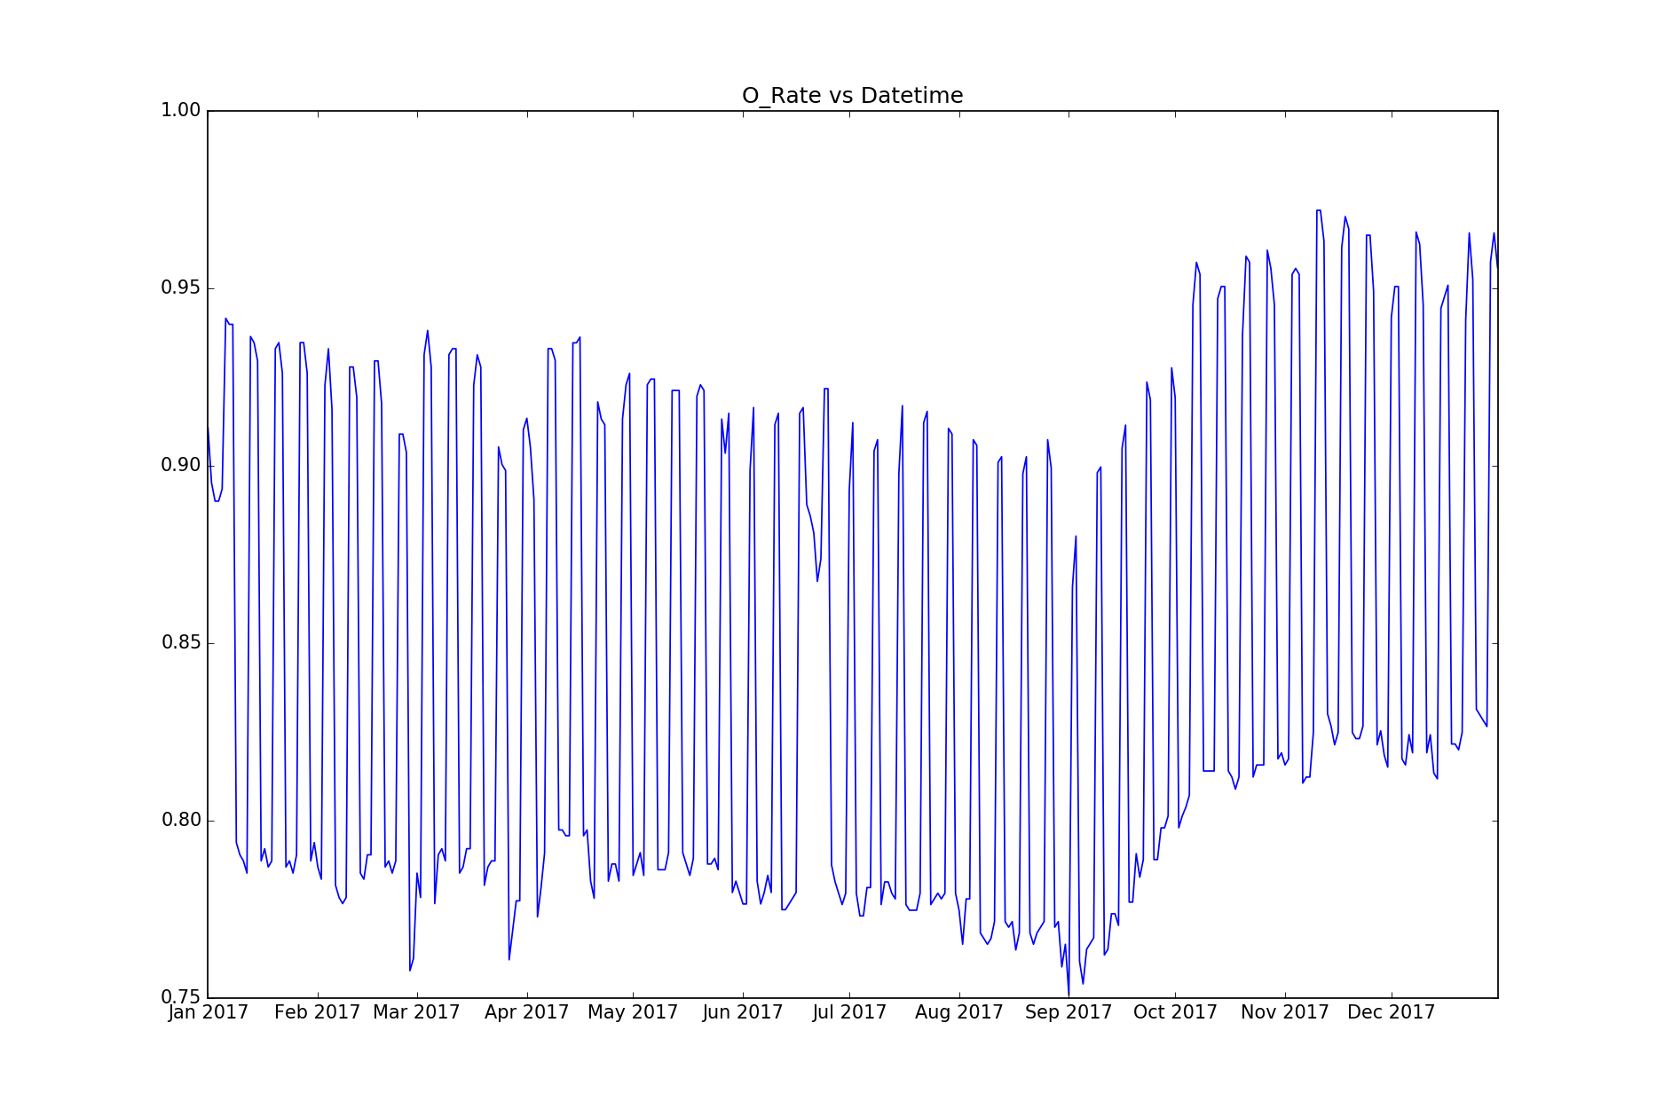
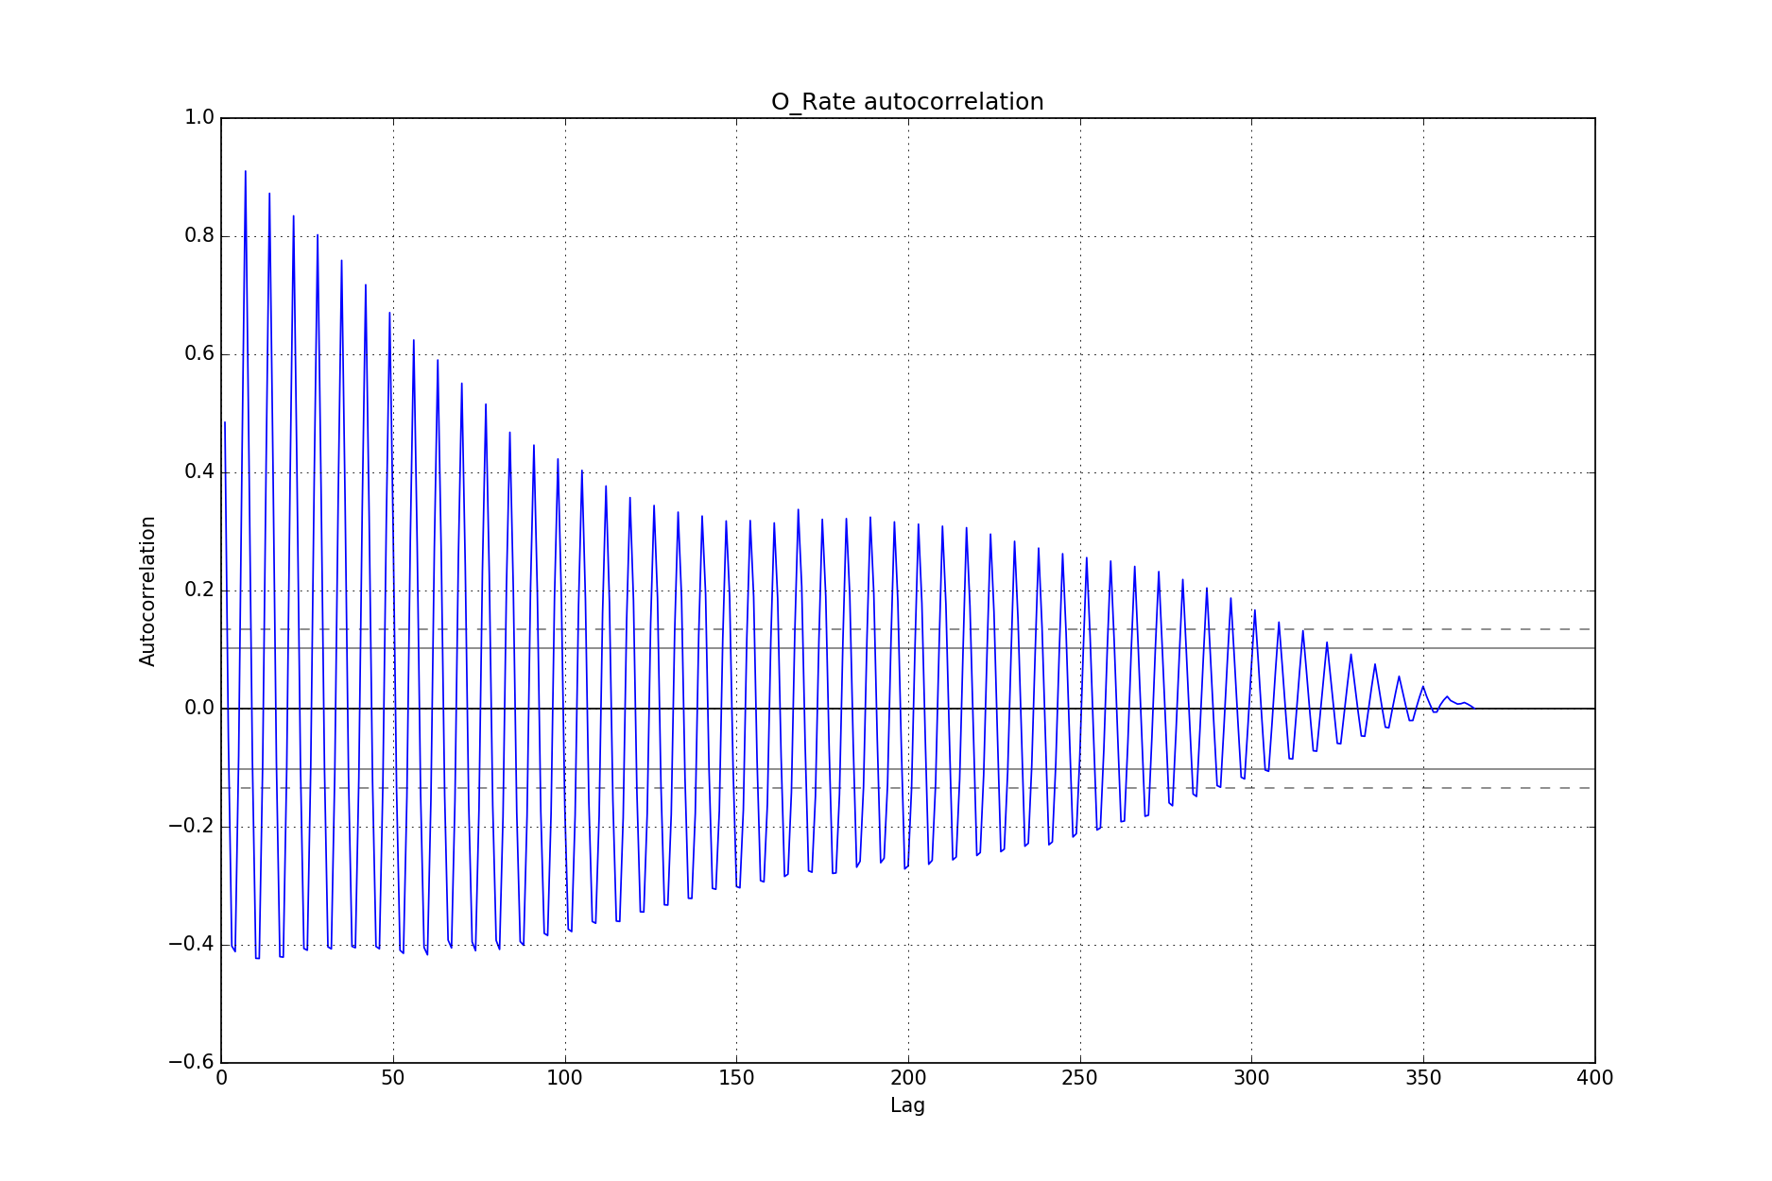
Sector Analysis – Co-Ed
Max Occupancy Rate: 97.0%
More than 20% difference
Min Occupancy Rate: 75.0%
Clear periodic pattern
7 peaks per 50 lags – weekly cycle
Peaks at Fri, Sat, Sun - weekend
Only exists in Co-Ed Sector
Notes:
For each 50 days we saw a total 7 peaks, that easily made us relate it to a weekly pattern.

Slide 25
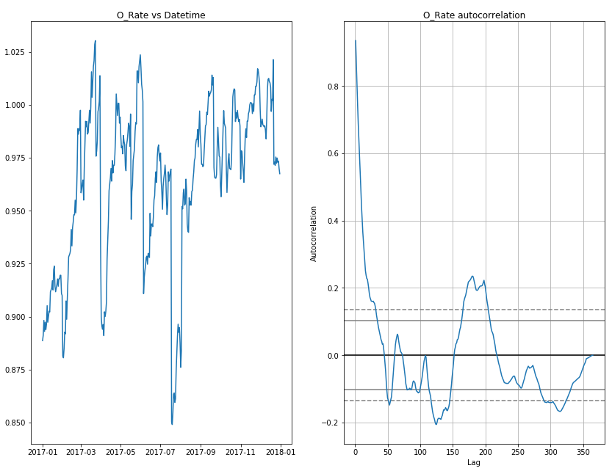
Sector Analysis - Families
Min Occupancy Rate: 89.0%
Max Occupancy Rate: 103.0%
Average Occupancy Rate: 96.4%
Capacity Change: 94.0%
Occupancy Change: 76.0%

Slide 26
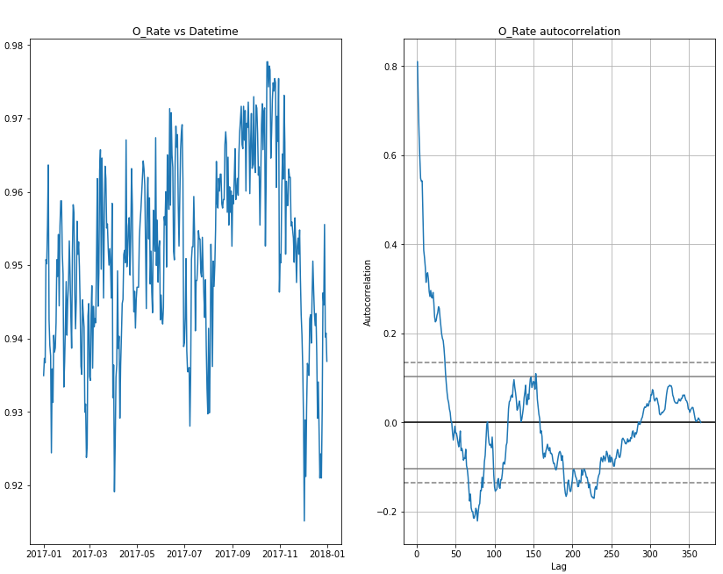
Sector Analysis – Male Adult
Min Occupancy Rate: 90.0%
Max Occupancy Rate: 98.0%
Average Occupancy Rate: 95.0%
Capacity % Change: 9.5%
Occupancy % Change: 6.8%

Slide 27
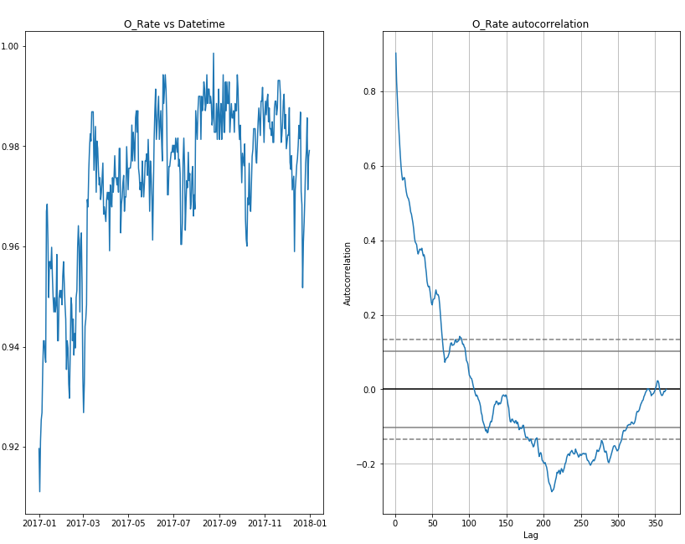
Sector Analysis – Female Adult
Min Occupancy Rate: 91.9%
Max Occupancy Rate: 99.0%
Average Occupancy Rate: 97.3%
Capacity Change: 10.0%
Occupancy Change: 8.6%

Slide 28
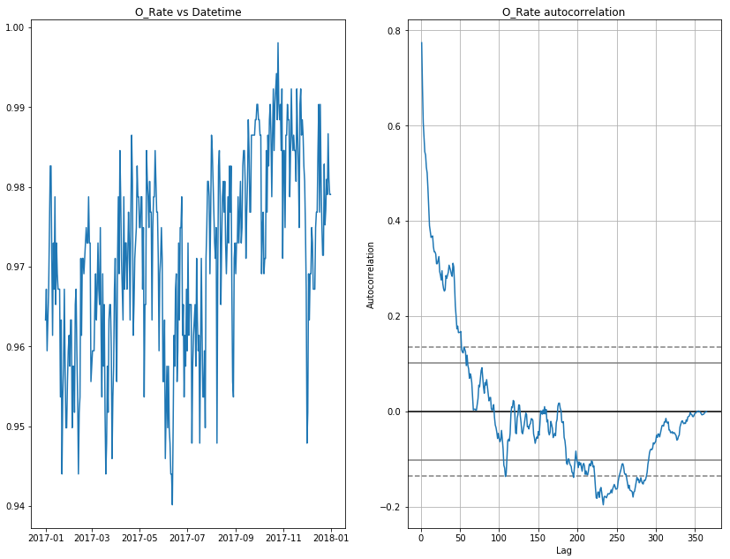
Sector Analysis – Youth
Min Occupancy Rate: 94.0%
Max Occupancy Rate: 99.8%
Average Occupancy Rate: 97.1%
Capacity Change: 1.4%
Occupancy Change: 6.4%

Slide 29
Conclusion

Slide 30
No obvious Correlation
Variation in weather condition doesn’t show any impact on shelter attributes when the city of Toronto’s shelter capacity is always in shortage.

Slide 31
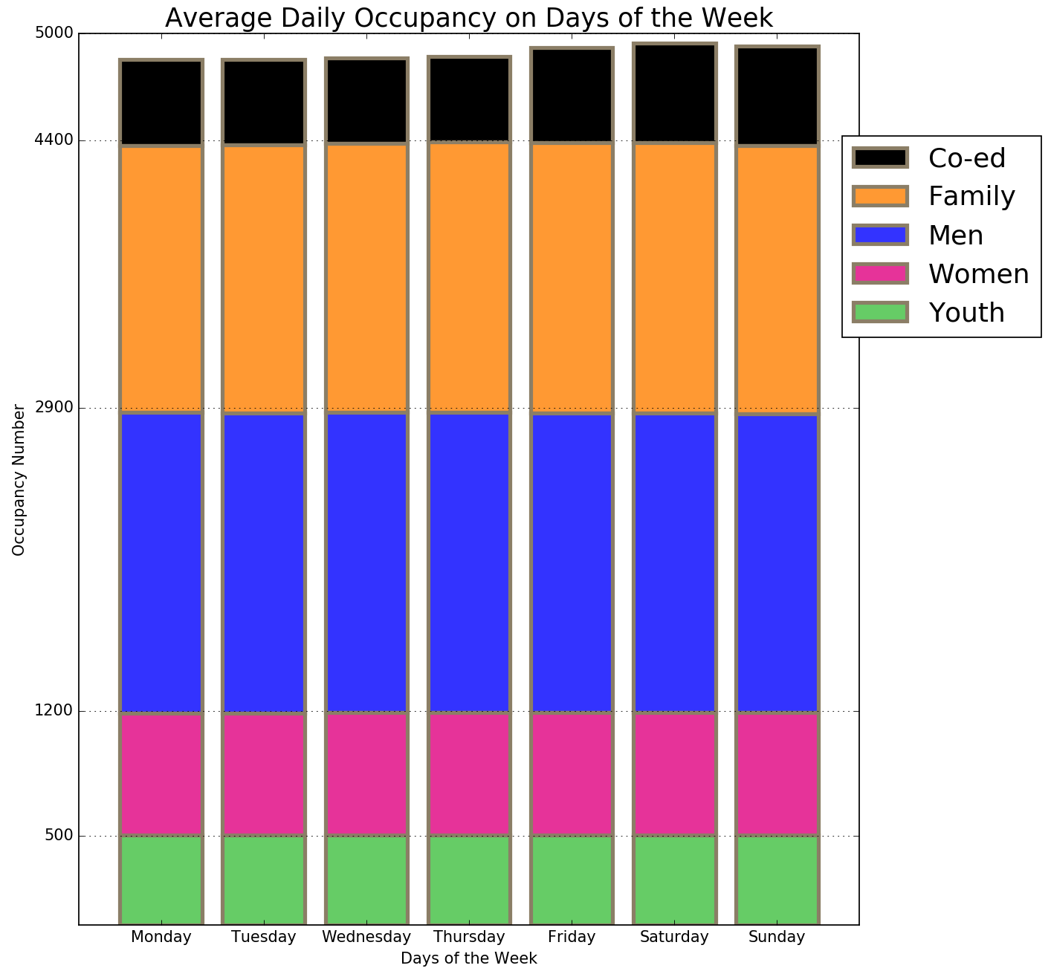
Sectors' contribution
Only the ‘Co-ed ‘Sector contributes to the overall weekly periodic pattern in occupancy.
Notes:
All other sectors have constant occupancy distribution over days of the week.
Only Co-ed sector showed variation between weekends and weekdays, and thus it contributes to the overall weekly pattern.
By 2% or 100 in number

Slide 32
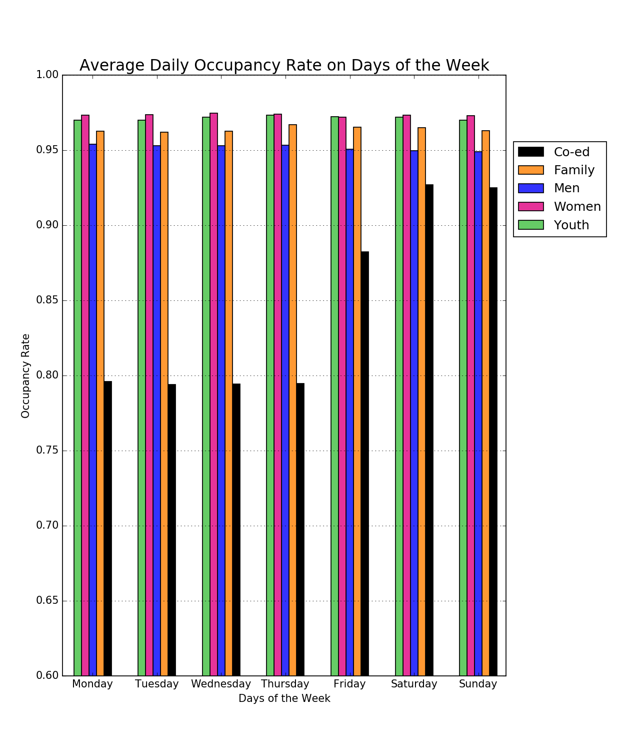
Occupancy Rate for different Sectors
A
B
Other sectors has very high averaged occupancy rate over 95% through out the week .
A
B
The ‘Co-ed ‘Sector has very high occupancy rates over the weekend.
Notes:
Similarly in the weekly pattern in occupancy rate,
All other sectors have constantly rate throughout the whole week, with average rate over 95%.
Co-ed showed an obvious variation between weekdays and weekends, difference around 10%. The weekday occupancy rate is below city’s target of 90%, around 80%.
Co-ed might be the people who refer to working homeless, probably they can find a shelter in weekdays at their working places, but will much more rely on city shelters over the weekends.
This may also imply the city of Toronto can re-allocate some of the Co-ed spaces to other sectors during the weekdays and set more temporary spaces for the Co-ed over the weekends. This might help to ease a little bit of the shortage of shelter space over the weekdays.
Toronto’s shelters are in crisis.

Slide 33
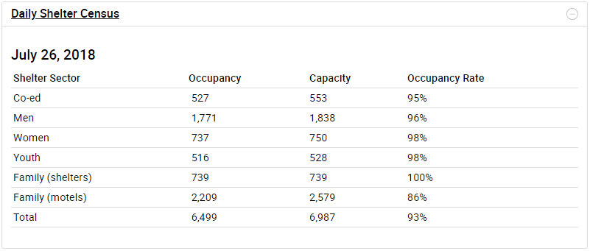
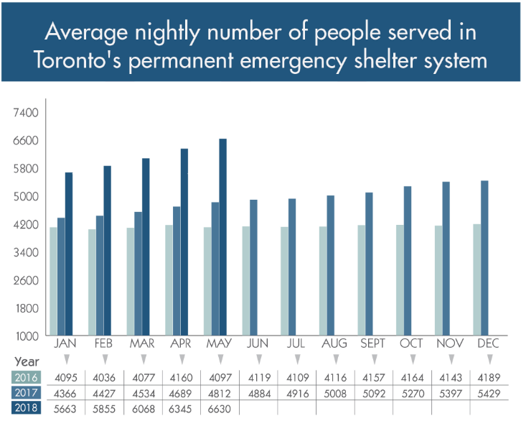
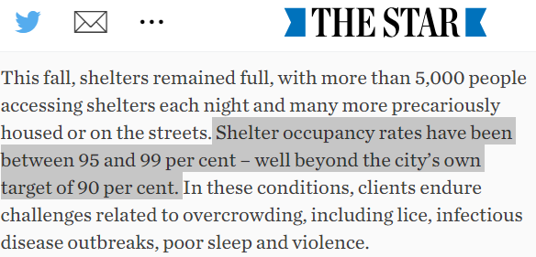
Toronto’s HOMELESS shelter crisis
https://www.toronto.ca/city-government/data-research-maps/research-reports/housing-and-homelessness-research-and-reports/
Notes:
Dec. 5, 2017, A important motion was presented to Toronto city council, calls for the city to create 1,000 new shelter beds.
Till today, we still experience a shelter system crisis
The answer to this crisis is a rapid expansion of subsidized, rent-geared-to-income housing. The recent announcement of Canada’s first national housing strategy, after many years of community advocacy, aims to cut chronic homelessness in half over the next 10 years, and promises investment in the construction of 100,000 new affordable housing units across the country. While a step in the right direction, even the very first of these new homes are years from being built and growing demand will still outpace new construction for many years.
In the first eight months of this year alone, according to Toronto Public Health, over 70 homeless people have died, a number that is likely an underestimate but which exceeds the city’s murder rate. Homelessness is among the leading causes of avoidable loss of life. More than half of those who have died in Toronto this year were younger than 48, a shocking reflection of the adversity faced by people without a home.
https://www.theglobeandmail.com/news/national/other-canadian-cities-avoid-torontos-homeless-shelter-crisis-by-focusing-on-housing-advocate/article37598769/
Homeless shelter emergencies aren't happening in other Canadian winter cities because they have focused on getting people into housing, says the head of a national group working to get people off the streets.
"The worry is it becomes a panic and becomes a focus on shelters," Richter said. "We have the emergency we're facing eclipsing the crisis that created the emergency.
"There's a couple of things that are different in Toronto," said city MP Adam Vaughan, chairman of an advisory committee on homelessness. "Toronto is a magnet to folks, not just regionally, but across the country and around the world.
"People come to Toronto looking for economic opportunity, but they also stay in Toronto because the services are strong."
Still, Vaughan agreed that the country's largest city does need to turn its attention to getting street people into homes.
"What we really ought to be doing is depopulating the shelters with supportive housing, which is cheaper," said Vaughan. "It's also more humane and it's where the homeless want to be."
Same thing is happening in London, New York and any other major cities in their country.

Slide 34


